Slide 1
CS4002 - PFC1
Computer vision
Computer vision is …
… a scientific field that extracts information out of digital images
… building algorithms that can understand the content of images and use it for other applications
Related areas: neuroscience, algorithm theory, machine learning, deep learning
Notes:
http://vision.stanford.edu/teaching/cs131_fall1718/files/cs131-class-notes.pdf

Slide 2

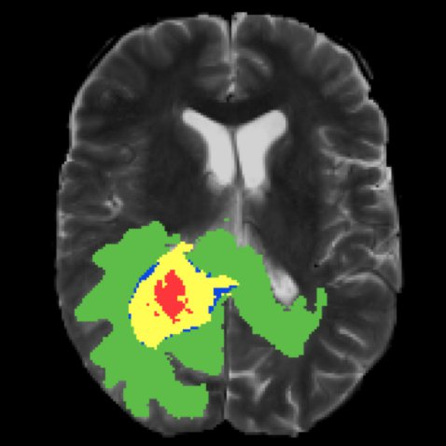
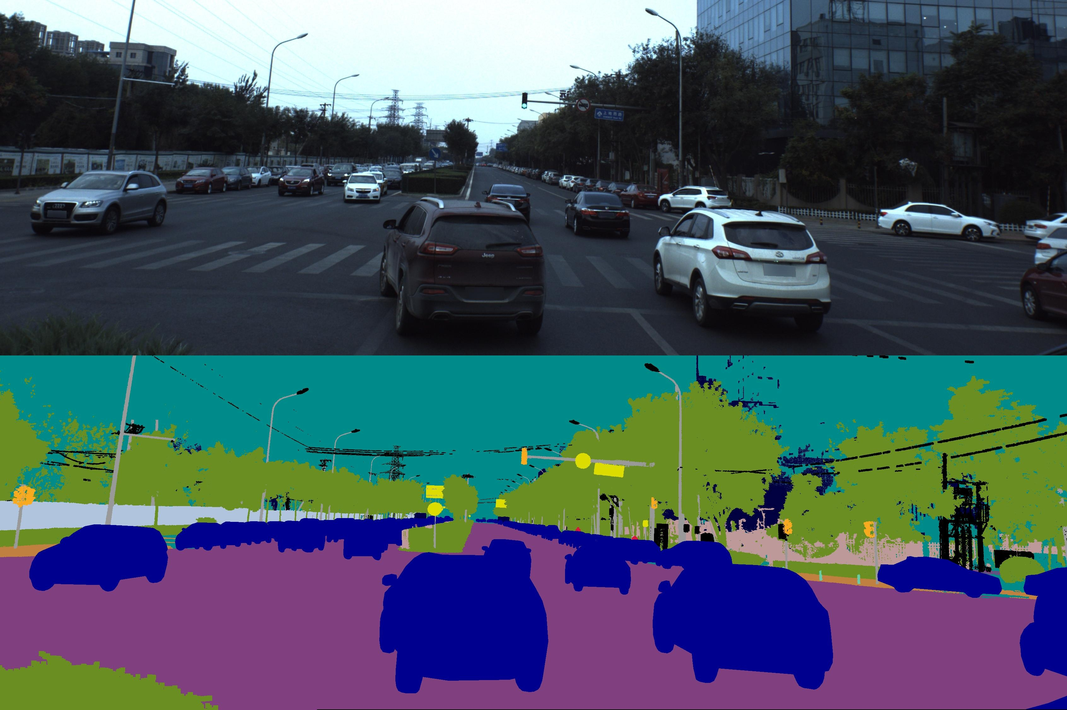
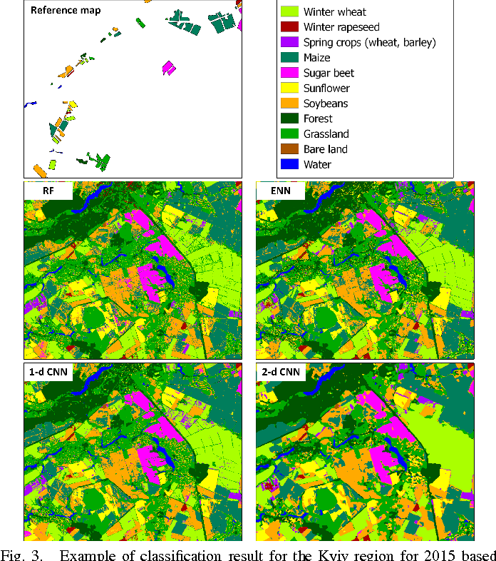
CS4002 - PFC1
Image segmentation applications
Autonomous navigation
Medical analysis
Remote sensing

Slide 3
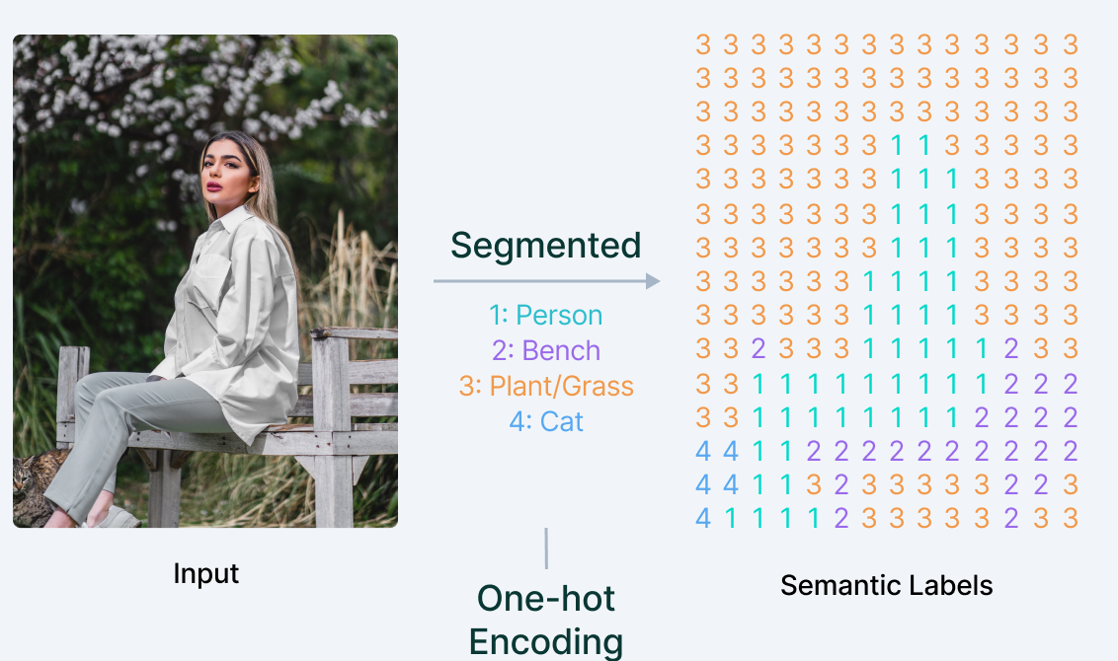
CS4002 - PFC1
Semantic segmentation
CHALLENGES:
Imbalanced class distributions.
Handling scale and resolution
Real-Time Performance
Notes:
Label correctly the segmentation boundaries in the reconstructed images.

Slide 4




CS4002 - PFC1
Datasets
VOC (Visual Object Classes Challenge)
BDD100K
Notes:
https://synscapes.on.liu.se/download.html (337GB)
https://host.robots.ox.ac.uk/pascal/VOC/voc2012/#history
https://www.kaggle.com/datasets/pablocumbrera/pascal-voc-2011-include-hands-foot-head
https://www.kaggle.com/datasets/huanghanchina/pascal-voc-2012
https://www.kaggle.com/datasets/solesensei/solesensei_bdd100k
https://www.kaggle.com/datasets/santurini/semantic-segmentation-drone-dataset
https://www.kaggle.com/datasets/xiaose/cityscapes

Slide 5
